Slide 1
Hedging Strategies Using Futures
Chapter 3

Slide 2
Long & Short Hedges
A long futures hedge is appropriate when you know you will purchase an asset in the future and want to lock in the price
A short futures hedge is appropriate when you know you will sell an asset in the future and want to lock in the price

Slide 3
Arguments in Favor of Hedging
Companies should focus on the main business they are in and take steps to minimize risks arising from interest rates, exchange rates, and other market variables

Slide 4
Arguments against Hedging
Shareholders are usually well diversified and can make their own hedging decisions
It may increase risk to hedge when competitors do not
Explaining a situation where there is a loss on the hedge and a gain on the underlying can be difficult

Slide 5
Basis Risk
Basis is the difference between spot & futures
Basis risk arises because of the uncertainty about the basis when the hedge is closed out

Slide 6
Long Hedge for Purchase of an Asset
Define
    F₁ : Futures price at time hedge is set up
    F₂ : Futures price at time asset is purchased
    S₂ : Asset price at time of purchase
    b₂ : Basis at time of purchase
Cost of asset | S₂
Gain on Futures | F₂ −F₁
Net amount paid | S₂ − (F₂ −F₁) =F₁ + b₂

Slide 7
Short Hedge for Sale of an Asset
Define
    F₁ : Futures price at time hedge is set up
    F₂ : Futures price at time asset is sold
    S₂ : Asset price at time of sale
    b₂ : Basis at time of sale
Price of asset | S₂
Gain on Futures | F₁ −F₂
Net amount received | S₂ + (F₁ −F₂) =F₁ + b₂

Slide 8
Choice of Contract
Choose a delivery month that is as close as possible to, but later than, the end of the life of the hedge
When there is no futures contract on the asset being hedged, choose the contract whose futures price is most highly correlated with the asset price. There are then 2 components to basis

Slide 9
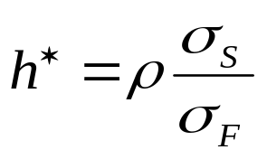
Optimal Hedge Ratio
Proportion of the exposure that should optimally be hedged is
where
σ_{S} is the standard deviation of ΔS, the change in the spot price during the hedging period,
σ_{F} is the standard deviation of ΔF, the change in the futures price during the hedging period
ρ is the coefficient of correlation between ΔS and ΔF.

Slide 10
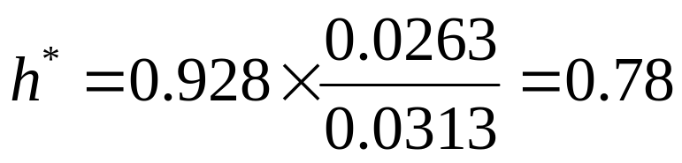
Example 3.5 (Page 62)
Airline will purchase 2 million gallons of jet fuel in one month and hedges using heating oil futures
From historical data σ_{F} =0.0313, σ_{S} =0.0263, and ρ= 0.928
Optimal number of contracts is 0.78×2,000,000/42,000 which rounds to 37

Slide 11
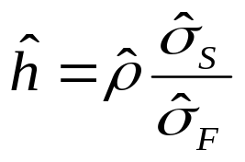



Alternative Definition of Optimal Hedge Ratio
Optimal hedge ratio is
where variables are defined as follows
 | Correlation between percentage daily changes for spot and futures
 | SD of percentage daily changes in spot
 | SD of percentage daily changes in futures

Slide 12
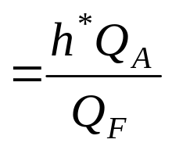
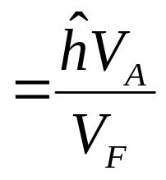
Optimal Number of Contracts
Q_{A} | Size of position being hedged (units)
Q_{F} | Size of one futures contract (units)
V_{A} | Value of position being hedged (=spot price time Q_{A})
V_{F} | Value of one futures contract (=futures price times Q_{F})
Optimal number of contracts after “tailing adjustment” to allow or daily settlement of futures
Optimal number of contracts if no adjustment for daily settlement

Slide 13
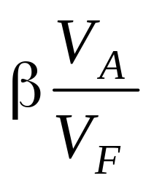
Hedging Using Index Futures
(Page 65)
To hedge the risk in a portfolio the number of contracts that should be shorted is
where V_{A} is the current value of the portfolio, β is its beta, and V_{F} is the current value of one futures (=futures price times contract size)

Slide 14
Example
Futures price of S&P 500 is 1,000
Size of portfolio is $5 million
Beta of portfolio is 1.5
One contract is on $250 times the index
What position in futures contracts on the S&P 500 is necessary to hedge the portfolio?

Slide 15
Changing Beta
What position is necessary to reduce the beta of the portfolio to 0.75?
What position is necessary to increase the beta of the portfolio to 2.0?

Slide 16
Why Hedge Equity Returns?
May want to be out of the market for a while. Hedging avoids the costs of selling and repurchasing the portfolio
Suppose stocks in your portfolio have an average beta of 1.0, but you feel they have been chosen well and will outperform the market in both good and bad times. Hedging ensures that the return you earn is the risk-free return plus the excess return of your portfolio over the market.

Slide 17
Stack and Roll (page 69-70)
We can roll futures contracts forward to hedge future exposures
Initially we enter into futures contracts to hedge exposures up to a time horizon
Just before maturity we close them out an replace them with new contract reflect the new exposure
etc

Slide 18
Liquidity Issues (See Business Snapshot 3.2)
In any hedging situation there is a danger that losses will be realized on the hedge while the gains on the underlying exposure are unrealized
This can create liquidity problems
One example is Metallgesellschaft which sold long term fixed-price contracts on heating oil and gasoline and hedged using stack and roll
The price of oil fell.....

